Slide 1
Advanced Stored Procedures
Mariella Di Giacomo
The Hive
mdigiacomo@thehive.com
dgmariella@yahoo.com

Slide 2
Outline
Stored Routines (SR) and Stored Program Language (SPL)
Inspecting SRs
Dynamic Structured Query Language (SQL)
Exception and Error Handling
Debugging SRs
Advantages and Disadvantages of SRs
Optimizations
Profiling SRs
Notes:
The Optimizations section will consists of two main sub sections:
SQL Optimizations. SRs as an alternative to Reducing Network Traffic and Complex SQL Statements
SRs Optimizations. This sub section will include: Branching and Looping optimizations, Cursor and Triggers Overhead, Recursion.

Slide 3
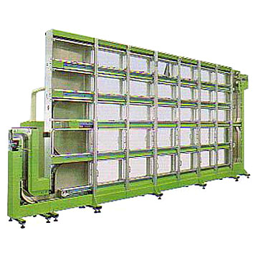


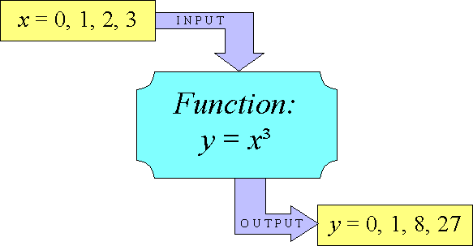




Stored Routines
Notes:
The image represents the Stored Routines, to be precise the Database containing Stored Routines, Stored Functions and Triggers.

Slide 4
Stored Routines
An SR is a subroutine available to applications accessing a relational database management system (RDBMS).
An SR is a program code (like in a regular computing language) stored in the database (DB) server.
MySQL SRs are written using the SPL based on a subset of the ANSI SQL:2003 SQL/Persistent Stored Module (PSM).
Notes:
The stored routine and language concept was introduced in the early 90’s.
MySQL PSL is very similar (uses the same ANSI SQL:2003 standard specification) to the PSL used by DB2 (one of IBM’s RDBMS),
while it is different from Oracle and Microsoft SQL PSL, which are very much proprietary.

Slide 5
Stored Routines
SPL/PSM is a block-structured language. It is not an object-oriented language.
An SR is saved in the SQL server and perhaps compiled when the source code is saved.
An SR runs, when called, in the context of the server, in one of the MySQL server process threads.

Slide 6
Stored Routines
An SR could be simply seen as a set of SQL statements. Its body is a list of SQL statements.
An SR has a name, may have a parameter list, and may contain a set of SQL statements.
An SR is created using the CREATE command.

Slide 7
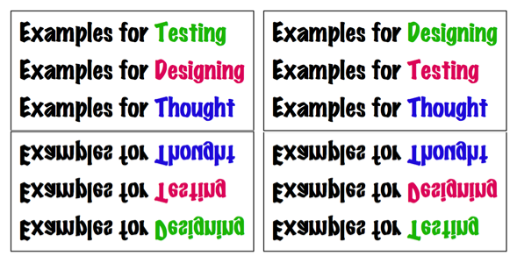
Stored Routines
DELIMITER //
CREATE PROCEDURE `DBName.AddData`(err VARCHAR(255))
BEGIN
…………
END;
//
DELIMITER ;
The example shows the CREATE command.

Slide 8
Stored Routines
An SR is, by default, created in the selected, current DB. In order to create an SR in another DB the name of the DB has to be prepended to the routine name.
An SR has inside the character ; which matches the default server command line delimiter. When writing the SR code, the command line delimiter needs to be changed to a different character.

Slide 9



Stored Routines
When an SR is invoked, an implicit USE DBName is performed (and undone when the SR terminates). USE statements within SRs are not allowed.
When a DB is dropped, all the SRs associated with it are dropped as well.
MySQL supports three types of routines:
  Stored Procedures (SP),
  Stored Functions (SF),
  Triggers.

Slide 10





Stored Routine Types

Slide 11
Stored Routine Types
An SP is a stored program that is called by using an explicit command (CALL). It does not return an explicit value.
An SF is a stored program that could be used as a user defined function and it is called by using just its name (without an explicit command). It can return a value that could be used in other SQL statements the same way it is possible to use pre-installed MySQL functions like pi(), replace(), etc.

Slide 12
Stored Routine Types
A Trigger is a stored unit of code that is attached to a table within the database. It is automatically created using the CREATE command. It is activated and called when a particular event (INSERT, UPDATE, REPLACE, DELETE) occurs for the table.

Slide 13
Stored Routines Types
CREATE PROCEDURE `DBName.AddData`(err VARCHAR(255))
…..
CALL AddData(“…”);
CREATE FUNCTION AddData()
RETURNS ……..
SELECT AddData();
CREATE TRIGGER AddData BEFORE INSERT ON table1 FOR EACH ROW BEGIN .. END;
The TRIGGER is automatically activated when the DML INSERT statement is executed.

Slide 14
Stored Routine Parameter Types
IN. This is the default (if not specified). It is passed to the routine and can be changed inside the routine, but remains unchanged outside.
OUT. No value is supplied to the routine (it is assumed to be NULL), but it can be modified inside the routine, and it is available outside the routine.
INOUT. The characteristics of both IN and OUT parameters. A value can be passed to the routine, modified there as well as passed back again.

Slide 15
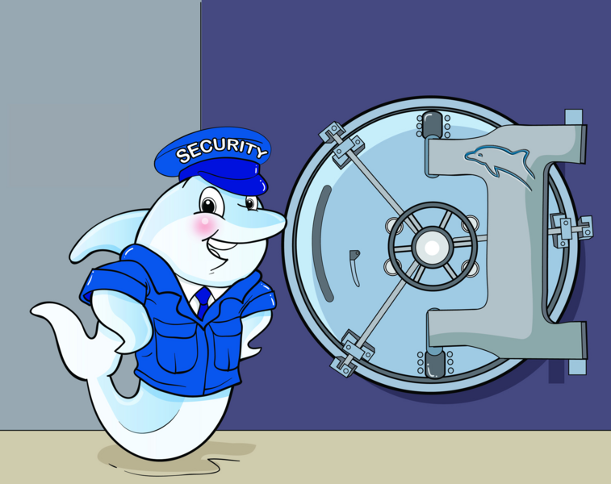
Stored Routine Security
Notes:
SRs can be created with two possible types of rights: “SQL SECURITY DEFINER” and “SQL SECURITY INVOKER”
When using “SQL SECURITY INVOKER” rights, the SR is executed with the rights of the caller, while with
“SQL SECURITY DEFINER” the SR is executed using the permissions of the user who created the routine.
When using “SQL SECURITY DEFINER” rights the execution of the routine in this mode
could be a powerful way of restricting ad hoc table modifications and avoiding security breaches.
By using “SQL SECURITY DEFINER” the SRs can ensure that the user gains access to the tables only via the code contained in the SRs.
This type of rights allows to grant permissions to use the DB only in ways that could be defined through the SRs.
The user calling the routine, needs to have only rights to execute the routine (only the EXECUTE privilege).
It is also possible to use “SQL SECURITY DEFINER” rights to ensure that transactions applied to the DB always conform to various business rules, etc..
This could become complicated when managing, keeping track of all the SRs and tables.
“SQL SECURITY DEFINER” rights could also be a problem when relying on traditional security privileges
to secure the database, especially when using Dynamic SQL and the SRs are not very sophisticated programs.
With Dynamic SQL, an SQL statement is constructed, parsed, and executed at runtime.
When using DYNAMIC SQL there is one case scenario, where SRs could be vulnerable to SQL injection attack:
when the stored program builds dynamic SQL using concatenation for the input parameters, without being checked.
SQL injection through SRs could be serious, since SRs that execute with “SQL SECURITY DEFINER” rights can execute SQL
Not normally available to the user invoking the SR.
Consider using “SQL SECURITY INVOKER” when a SR includes dynamic SQL.
When using dynamic SQL, validate input parameters and use the “INVOKER” rights.

Slide 16

Stored Routine Security
Access to an SR must be explicitly granted to users that did not create it and plan to use it.
It is possible to give greater privileges to tables than those users that execute the SR.
It is possible to create an environment more resistant to SQL injections.

Slide 17
Stored Procedures

Slide 18
Stored Procedures
An SP is a set of SQL statements that can be stored in the server. Once this has been done, clients don't need to keep reissuing the individual statements but can refer to the stored procedure instead.
An SP can be created using the CREATE command.
None of the three type of parameters is required in an SP.

Slide 19
Stored Procedures
An SP always ends its name definition when created with (), even though it does not have parameters (there is always the trailing ()).
A SP is called using an explicit CALL command.
An SP that does not have parameters, can be called without trailing ().

Slide 20
Stored Procedures
An SP name should be different than existing SQL functions, otherwise you must insert a space between the name and the parenthesis, when defining and calling it.
An SP may display results or return the result into output variables that have been specified.
Notes:
An SP may or may not display results.
SR names should be different than existing SQL functions, otherwise you must insert a space between the name and the parenthesis, when defining and calling a Stored Procedure or a Stored Function. Triggers must have names different than existing SQL functions.

Slide 21
Stored Procedure Environment
The environment where an SP is stored and could be examined in the server data dictionary.
An SP is stored in a special table called mysql.proc within a database's namespace.
The information associated to an SP can be seen using the SHOW CREATE PROCEDURE command.
The information associated to an SP status can be seen using the SHOW PROCEDURE STATUS command.

Slide 22
Stored Procedure Environment
The result of the last two statements can also be obtained using the information schema database and the routines table.
SELECT * FROM INFORMATION_SCHEMA.ROUTINES WHERE ROUTINE_NAME=‘SPName' \G

Slide 23
Stored Functions

Slide 24
Stored Functions
An SF is a routine that could be used in other SQL statements the same way it is possible to use defined MySQL functions like length(), etc.
An SF cannot display results.
An SF is created using the CREATE command.
The input parameters (IN) are not required in an SF. An SF must have a RETURN statement and can only return one value.

Slide 25
Stored Functions
An SF it is called just by using its name.
An SF name should be different than existing SQL functions, otherwise you must insert a space between the name and the parenthesis, when defining and calling it.

Slide 26
Stored Function Environment
The environment where an SF is stored and could be examined is the server data dictionary.
An SF is stored in a special table called mysql.proc within a database's namespace.
The information associated to a SF could be seen using the SHOW CREATE FUNCTION command.
The information associated to an SF status could be seen using the SHOW FUNCTION STATUS command.

Slide 27
Stored Function Environment
The result of the last two statements can also be achieved using the information schema database and the ROUTINES table.
SELECT * FROM INFORMATION_SCHEMA.ROUTINES WHERE ROUTINE_NAME=‘SFName' \G

Slide 28





Triggers
Notes:
The images represent several types of TRIGGER fish

Slide 29
Triggers
A Trigger is a named database object that is associated with a table and that is activated when a particular event occurs for the table.
It can be used in response to an event, typically a DML operation (INSERT, UPDATE, REPLACE, DELETE).
Two commands are associated to a Trigger: CREATE and DROP.
Triggers must have different names than existing SQL functions.

Slide 30
Triggers
MySQL Triggers are associated to a table and are currently stored in .TRG files, with one such file one per table (tablename.TRG) and in .TRN files, with one such file per trigger (triggername.TRN).
A Trigger is (MySQL 5.0.x) FOR EACH ROW. It is activated for each row that is inserted, updated, or deleted.
MySQL 5.0.x supports only Triggers using FOR EACH ROW statement.
Notes:
The tablename.TRG file contains the body, sql mode, definers, type (TYPE=TRIGGERS), etc.
The triggername.TRN contains the table to which it refers, type (TYPE=TRIGGERNAME)

Slide 31

Stored Program Language
MySQL Stored Programming Language (based on the ANSI SQL-2003 PSM specification) is a block-structured language that supports all the fundamentals that you would expect from a Procedural Language (PL).

Slide 32
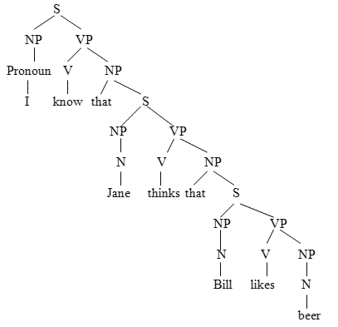
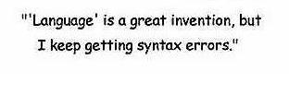
SPL Syntax

Slide 33
SPL Syntax
The SPL Syntax section contains:
  CREATE, ALTER, DROP, CALL Statements,
  BEGIN .. END Construct,
  DECLARE, SET Statements,
  OPEN, FETCH, CLOSE CURSOR,
  Flow Control Constructs.

Slide 34
SPL Syntax
CREATE [DEFINER = { user | CURRENT_USER }] PROCEDURE SPName ([[IN | OUT | INOUT] param SQLDataType [,...]])
[LANGUAGE SQL |
[NOT] DETERMINISTIC |
{ CONTAINS SQL | NO SQL | READS SQL DATA | MODIFIES SQL DATA }
| SQL SECURITY { DEFINER | INVOKER }
| COMMENT 'string'
SQL STATEMENTS

Slide 35
SPL Syntax
DELIMITER //
CREATE PROCEDURE InfoInit (t1pVARCHAR(32), t2p VARCHAR(32), etype VARCHAR(20), fid INT)
SQL SECURITY INVOKER
BEGIN
……
END
//
DELIMITER ;

Slide 36
SPL Syntax
CREATE [DEFINER = { user | CURRENT_USER }] FUNCTION SFName ([param SQLDataType [,...]])
RETURNS SQLDataType
LANGUAGE SQL
| [NOT] DETERMINISTIC
| { CONTAINS SQL | NO SQL | READS SQL DATA | MODIFIES SQL DATA }
| SQL SECURITY { DEFINER | INVOKER }
| COMMENT 'string'
SQL STATEMENTS

Slide 37
SPL Syntax
ALTER {PROCEDURE | FUNCTION} SRName
{ CONTAINS SQL | NO SQL | READS SQL DATA | MODIFIES SQL DATA }
| SQL SECURITY { DEFINER | INVOKER }
| COMMENT 'string‘
DROP {PROCEDURE | FUNCTION} [IF EXISTS] SRName
CALL SPName([parameter [,...]])
CALL SPNname[()]

Slide 38
SPL Syntax
DROP FUNCTION IF EXISTS DistKM;
DELIMITER |
CREATE FUNCTION DistKM( lat1 FLOAT, lon1 FLOAT, lat2 FLOAT, lon2 FLOAT ) RETURNS float
BEGIN
………..
RETURN 6378.388;
END;
|
DELIMITER ;

Slide 39
SPL Syntax
ALTER FUNCTION DistKm SQL SECURITY INVOKER COMMENT 'This functions returns ........';
DROP FUNCTION IF EXISTS DistKM;
CALL InfoInit(“info1”, “info2”, “info3”, 64);
SELECT DistKm(23.4, 34.5, 23.1, 22.1);
RETURN expr;
RETURN 6378.388;

Slide 40
SPL Syntax
CREATE [DEFINER = { user | CURRENT_USER }]
TRIGGER TriggerName trigger_time trigger_event
ON TableName FOR EACH ROW TriggerStmt
DROP TRIGGER [IF EXISTS] [SchemaName.]TriggerName

Slide 41

SPL Syntax
CREATE TABLE table1(a1 INT);
CREATE TABLE table2(a2 INT);
CREATE TABLE table3(a3 INT NOT NULL AUTO_INCREMENT PRIMARY KEY);
DELIMITER |
CREATE TRIGGER TriggerExample
BEFORE INSERT ON table1 FOR EACH ROW
BEGIN
INSERT INTO table2; SET a2 = NEW.a1;
DELETE FROM table3 WHERE a3 = NEW.a1;
END;
|
DELIMITER ;

Slide 42
SPL Syntax
BEGIN ….. END
SET VarName = expr [, VarName = expr] …
DECLARE VarName[,...] type [DEFAULT value]
SELECT ColName[,...] INTO VarName[,...] TableExpr
DECLARE CursorName CURSOR FOR SelectStatement
OPEN CursorName;
FETCH CursorName INTO VarName;
CLOSE CursorName;

Slide 43
SPL Syntax
DECLARE ConditionName CONDITION FOR SQLSTATE [VALUE] | MySqlErrorCode
DECLARE [EXIT | CONTINUE | UNDO] HANDLER FOR ConditionValue[,...] Statement
ConditionValue:
SQLSTATE [VALUE] SQLStateValue | ConditionName
| SQLWARNING | NOT FOUND | SQLEXCEPTION
| MySqlErrorCode

Slide 44
SPL Syntax
BEGIN
DECLARE pi, price FLOAT;
DECLARE error FLOAT DEFAULT 0;
DECLARE EXIT HANDLER FOR SQLEXCEPTION SET error=1;
SET @x = 2;
…………
SET pi = PI();
……..
END;
Notes:
DECLARE Statement Examples (Local Variables, Session Variables, Error Handlers)

Slide 45
SPL Syntax
BEGIN
DECLARE v_id INTEGER;
DECLARE v_text VARCHAR(45);
DECLARE done INT DEFAULT 0;
DECLARE c CURSOR FOR SELECT c_id, c_text FROM statements;
DECLARE CONTINUE HANDLER FOR SQLSTATE '02000' SET done = 1;
…...
END
Notes:
DECLARE Statement Examples (Local Variables, Cursor, Last Row Condition Handler)

Slide 46
SPL Syntax
BEGIN
……..
DECLARE c CURSOR FOR SELECT col1 FROM statements;
DECLARE CONTINUE HANDLER FOR SQLSTATE '02000' SET done = 1;
……
OPEN c;
REPEAT
FETCH c INTO v_id, v_text;
IF NOT done THEN …..
….
CLOSE c;
….
END

Slide 47
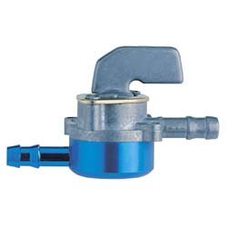
SPL Syntax
Flow Control Constructs

Slide 48
SPL Syntax
IF search_condition THEN statement_list
[ELSEIF search_condition THEN statement_list] ….
[ELSE statement_list]
END IF

Slide 49
SPL Syntax
IF error=0 THEN
………
ELSEIF error=1 THEN …..;
ELSE
SELECT 'Error ' as result;
END IF;

Slide 50
SPL Syntax
DELIMITER //
CREATE FUNCTION SimpleCompare(i INT, j INT) RETURNS VARCHAR(20)
BEGIN
DECLARE s VARCHAR(20);
………………….
IF j > i THEN s = '>';
ELSEIF i = j THEN s = '=';
ELSE s = '<'
END IF;
…….
s = CONCAT(j, ' ', s, ' ', i);
…….
RETURN s;
END //
DELIMITER ;

Slide 51
SPL Syntax
CASE VarName
WHEN VarValue1 THEN Statement/s
WHEN VarValue2 THEN Statement/s
......
ELSE Statement/s
END CASE

Slide 52
SPL Syntax
………..
DECLARE v INT DEFAULT 1;
CASE v
WHEN 2 THEN SELECT v;
WHEN 3 THEN SELECT 0;
......
ELSE
BEGIN
END;
END CASE;
......

Slide 53
SPL Syntax
CASE
WHEN SearchCondition THEN Statement/s
WHEN SearchCondition THEN Statement/s
ELSE Statement/s
END CASE

Slide 54
SPL Syntax
………..
DECLARE v INT DEFAULT 1;
CASE
WHEN v=2 THEN SELECT v;
WHEN v=3 THEN SELECT 0;
......
ELSE
BEGIN
END;
END CASE;
......

Slide 55
SPL Syntax
LABEL
BLABEL: BEGIN
…….
END BLABEL;
ITERATE LABEL
[LABEL:] LOOP
Statement/s
LEAVE LABEL
END LOOP [LABEL];

Slide 56
SPL Syntax
CREATE PROCEDURE SimpleIterate(j INT)
BEGIN
loop1: LOOP
SET j = j + 1;
IF j < 10 THEN ITERATE loop1; END IF;
LEAVE loop1;
END LOOP loop1;
SET @x = j;
END;
Jjjjj
kkk

Slide 57
SPL Syntax
[LABEL:] REPEAT
Statement/s
UNTIL SearchCondition
END REPEAT [LABEL]
[LABEL:] WHILE SearchCondition DO
Statement/s
END WHILE [LABEL]

Slide 58
SPL Syntax
DELIMITER //
CREATE PROCEDURE SimpleRepeat(p1 INT)
BEGIN
SET @x = 0;
REPEAT SET @x = @x + 1; UNTIL @x > p1 END REPEAT;
END
//
DELIMITER ;

Slide 59
SPL Syntax
CREATE PROCEDURE SimpleWhile()
BEGIN
DECLARE v1 INT DEFAULT 5;
WHILE v1 > 0 DO
...
SET v1 = v1 - 1;
END WHILE;
END

Slide 60


Inspecting Stored Routines

Slide 61
Inspecting Stored Routines
The information associated to an SR could be seen using the SHOW CREATE PROCEDURE | FUNCTION command.
SHOW CREATE {PROCEDURE | FUNCTION} SPName
The information associated to an SP status could be seen using the SHOW PROCEDURE | FUNCTION STATUS command.
SHOW {PROCEDURE | FUNCTION}
[LIKE 'pattern' | WHERE expr]

Slide 62

Inspecting Stored Routines
SELECT * FROM INFORMATION_SCHEMA.ROUTINES \G
SELECT * FROM INFORMATION_SCHEMA.ROUTINES WHERE ROUTINE_NAME=‘SRName' \G

Slide 63
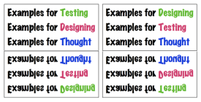
Inspecting Stored Routines
show create procedure AddData \G
*************************** 1. row ***************************
Procedure: AddData
sql_mode:
Create Procedure: CREATE DEFINER=`root`@`localhost` PROCEDURE `AddData`(ident BIGINT UNSIGNED)
MODIFIES SQL DATA
BEGIN
DECLARE uid BIGINT UNSIGNED;
DECLARE p_sqlcode INT DEFAULT 0 ;
DECLARE p_message VARCHAR(255) ;
BLABEL: BEGIN
DECLARE DUPLICATE_KEY CONDITION FOR 1062;
DECLARE CONTINUE HANDLER FOR DUPLICATE_KEY BEGIN SET p_sqlcode=1052; SET p_message='Duplicate Key error'; END;
DECLARE CONTINUE HANDLER FOR NOT FOUND BEGIN SET p_sqlcode=1329; SET p_message='No Record Found'; END;
INSERT INTO user VALUES (ident);
IF (p_sqlcode=0) THEN SELECT 'Success' as result;
ELSE CALL UserSignal(p_sqlcode,p_message); LEAVE BLABEL;
END IF;
END BLABEL;
END

Slide 64
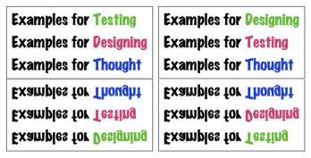
Inspecting Stored Routines
show procedure status like 'AddData' \G
Db: examples
Name: AddData
Type: PROCEDURE
Definer: root@localhost
Modified: 2008-03-19 11:57:49
Created: 2008-03-19 11:57:49
Security_type: DEFINER
Comment: This procedure ………

Slide 65
Inspecting Stored Routines
SELECT * FROM information_schema.routines WHERE ROUTINE_NAME="AddData" \G
SPECIFIC_NAME: AddData
ROUTINE_CATALOG: NULL
ROUTINE_SCHEMA: examples
ROUTINE_NAME: AddData
ROUTINE_TYPE: PROCEDURE
DTD_IDENTIFIER: NULL
ROUTINE_BODY: SQL
ROUTINE_DEFINITION: BEGIN
DECLARE uid BIGINT UNSIGNED;
DECLARE p_sqlcode INT DEFAULT 0 ;
DECLARE p_message VARCHAR(255) ;
BLABEL: BEGIN
DECLARE DUPLICATE_KEY CONDITION FOR 1062;
DECLARE CONTINUE HANDLER FOR DUPLICATE_KEY BEGIN SET p_sqlcode=1052; SET p_message='Duplicate Key error'; END;
DECLARE CONTINUE HANDLER FOR NOT FOUND BEGIN SET p_sqlcode=1329; SET p_message='No Record Found'; END;
INSERT INTO user VALUES (ident);
IF (p_sqlcode=0) THEN SELECT 'Success' as result;
ELSE CALL UserSignal(p_sqlcode,p_message); LEAVE BLABEL;
END IF;
END BLABEL;
END

Slide 66
Inspecting Stored Routines
……….
EXTERNAL_NAME: NULL
EXTERNAL_LANGUAGE: NULL
PARAMETER_STYLE: SQL
IS_DETERMINISTIC: NO
SQL_DATA_ACCESS: MODIFIES SQL DATA
SQL_PATH: NULL
SECURITY_TYPE: DEFINER
CREATED: 2008-03-19 11:57:49
LAST_ALTERED: 2008-03-19 11:57:49
SQL_MODE:
ROUTINE_COMMENT:
DEFINER: root@localhost

Slide 67


Dynamic SQL

Slide 68
Dynamic SQL
Dynamic SQL, server-side prepared statements, is an API for preparing SQL statements for repeated execution efficiently and almost securely.
Dynamic SQL offers a tremendous amount of flexibility, but also some complexity and a little risk related to SQL injections if the stored program is not sophisticated.
Notes:
With Dynamic SQL, an SQL statement is constructed, parsed, and executed at runtime.
When using DYNAMIC SQL there is one case scenario, where SRs could be vulnerable to SQL injection attack:
when the stored program builds dynamic SQL using concatenation for the input parameters, without being checked.
SQL injection through SRs could be serious, since SRs that execute with “SQL SECURITY DEFINER” rights can execute SQL
that may not normally be available to the user invoking the SR.
Consider using “SQL SECURITY INVOKER” when a SR includes dynamic SQL and validate input parameters.
Carefully validate any parameter values that might be used to construct dynamic SQL.

Slide 69
Dynamic SQL
With Dynamic SQL, an SQL statement is constructed, parsed, and executed at runtime (PREPARE, EXECUTE, DEALLOCATE), not at the time the code is compiled.
Dynamic SQL is only allowed in SPs.

Slide 70
Dynamic SQL
DROP PROCEDURE IF EXISTS dsql;
DELIMITER //
CREATE PROCEDURE dsql( field1 VARCHAR(20), val1 INT, val2 INT, val3 INT)
BEGIN
PREPARE stmt FROM "SELECT * FROM user LIMIT ?, ?";
SET @a=val1, @b=val2, @c=val3, @d=field1;
EXECUTE stmt USING @b, @c;
SET @table_name="user";
SET @stmt_text=CONCAT("select ", field1, " from ", @table_name, " limit ?");
PREPARE stmt FROM @stmt_text;
EXECUTE stmt USING @c;
DEALLOCATE PREPARE stmt;
SET @stmt_text=CONCAT("select * from ", @table_name, " WHERE " , field1, " = ?", " limit ?");
PREPARE stmt FROM @stmt_text;
EXECUTE stmt USING @c,@b;
DEALLOCATE PREPARE stmt;
END;
//
DELIMITER ;
Notes:
Consider using “SQL SECURITY INVOKER” when a SR includes dynamic SQL and validate input parameters.

Slide 71
Dynamic SQL
DROP PROCEDURE IF EXISTS dsql;
DELIMITER //
CREATE PROCEDURE dsql( field1 VARCHAR(20), table1 VARCHAR(20), val1 INT, val2 INT, val3 VARCHAR(100))
BEGIN
DECLARE var INTEGER DEFAULT 1;
SET @a=val1, @b=val2, @c=val3, @d=field1;
SET @stmt_text=CONCAT("select ", field1, " from ", table1, " WHERE ", field1 ," = ?“ );
PREPARE stmt FROM @stmt_text;
EXECUTE stmt USING @c;
DEALLOCATE PREPARE stmt;
END;
//
DELIMITER ;
SQL injection FAIILS.
CALL dsql("id","user",1,2, '22 UNION select id from user'); or CALL dsql("id","user",1,2, '22 UNION ALL select id from user');
The result of the call is
id: 22
Notes:
Consider using “SQL SECURITY INVOKER” when a SR includes dynamic SQL and validate input parameters.

Slide 72
Dynamic SQL
DROP PROCEDURE IF EXISTS dsql;
DELIMITER //
CREATE PROCEDURE dsql( field1 VARCHAR(20), table1 VARCHAR(20), val1 INT, val2 INT, val3 VARCHAR(100))
BEGIN
DECLARE var INTEGER DEFAULT 1;
SET @a=val1, @b=val2, @c=val3, @d=field1;
SET @stmt_text=CONCAT("select ", field1, " from ", table1, " WHERE ", field1 ,"=", val3);
PREPARE stmt FROM @stmt_text;
EXECUTE stmt;
DEALLOCATE PREPARE stmt;
END;
//
DELIMITER ;
SQL injection SUCCEEDED.
CALL dsql("id","user",1,2, '22 UNION select id from user'); or CALL dsql("id","user",1,2, '22 UNION ALL select id from user');
The result of the call is id: 22 plus the all the of the user identifiers.
Do not concatenate input values instead use placeholders, if possible. Perform input parameter checking.

Slide 73
Dynamic SQL
DROP PROCEDURE IF EXISTS dsql;
DELIMITER //
CREATE PROCEDURE dsql( field1 VARCHAR(20), table1 VARCHAR(20), val1 INT, val2 INT, val3 INT)
BEGIN
DECLARE var INTEGER DEFAULT 1;
SET @a=val1, @b=val2, @c=val3, @d=field1;
SET @stmt_text=CONCAT("select ", field1, " from ", table1, " WHERE ", field1 ,"=", val3);
PREPARE stmt FROM @stmt_text;
EXECUTE stmt;
DEALLOCATE PREPARE stmt;
END;
//
DELIMITER ;
SQL injection FAILS, because of the val3 INT use.
CALL dsql("id","user",1,2, '22 UNION select id from user'); or CALL dsql("id","user",1,2, '22 UNION ALL select id from user');
The result of the call is id: 22 and a warning
Warning | 1265 | Data truncated for column 'val3' at row 1
The use of val3 INT allowed the program to truncate the input parameter and avoid injection

Slide 74
Dynamic SQL
DROP PROCEDURE IF EXISTS dsql;
DELIMITER //
CREATE PROCEDURE dsql( field1 VARCHAR(20), table1 VARCHAR(20), val1 INT, val2 INT, val3 INT)
BEGIN
DECLARE var INTEGER DEFAULT 1;
SET @a=val1, @b=val2, @c=val3, @d=field1;
SET @stmt_text=CONCAT("select ", field1, " from ", table1, " WHERE ", field1 ,"=", val3);
PREPARE stmt FROM @stmt_text;
EXECUTE stmt;
DEALLOCATE PREPARE stmt;
END;
//
DELIMITER ;
In this case the SQL MODE used is strict. SQL injection FAILS
CALL dsql("id","user",1,2, '22 UNION select id from user'); or CALL dsql("id","user",1,2, '22 UNION ALL select id from user');
The result of the call is:
ERROR 1265 (01000): Data truncated for column 'val3' at row 1
The use of val3 INT and strict mode allowed the program to generate and error and avoid injection
Notes:
A ‘strict mode’, can be achieved when one of TRADITIONAL, STRICT_TRANS_TABLES, or STRICT_ALL_TABLES mode is enabled.

Slide 75
Dynamic SQL
DROP PROCEDURE IF EXISTS dsql;
DELIMITER //
CREATE PROCEDURE dsql(table1 VARCHAR(20), field1 VARCHAR(20), val1 VARCHAR(100))
BEGIN
DECLARE var INTEGER DEFAULT 1;
SET @a:=val1;
SET @stmt_text=CONCAT("select * FROM “, table1, “ WHERE “, field1 , “ = ?");
PREPARE stmt FROM @stmt_text;
EXECUTE stmt USING @a;
DEALLOCATE PREPARE stmt;
END;
//
DELIMITER ;
SQL injection FAILS.
In this case the ident field is a varchar(20)
CALL dsql(“user”,”ident”,“value1 UNION ALL select ident from user");
| value1 UNION ALL select ident from user

Slide 76



Error and Exception Handling

Slide 77
Error and Exception Handling
MySQL Error Handlers let catch, trap error conditions and take, handle the appropriate actions. Without error handlers, an SR will abort whenever it encounters SQL errors, returning control to the calling program.
Handlers can be constructed to catch all the errors, although this is currently not best practice in MySQL.
Handlers must be defined after any variable or cursor declarations.

Slide 78
Error and Exception Handling
Handlers can be constructed to catch either ANSI-standard SQL_STATE codes or MySQL specific error codes.
Handlers constitute of three main clauses: type (CONTINUE, EXIT), condition (SQLSTATE, MySQL Error Code, Named Condition) and actions.
To improve code readability, named conditions should be declared against the error codes that are handled.

Slide 79
Error and Exception Handling
MySQL will deliver in the next releases the ability to manage all the possible exceptions with a single handler and the possibility to SIGNAL user defined exceptions. Will be possible to access directly the SQLSTATE variables, as well as the ability to raise an error condition using the SIGNAL statement.

Slide 80
Handler Types
Condition Handlers could be of two types:
EXIT and CONTINUE.
The choice between creating an EXIT handler and creating a CONTINUE handler is based primarily on program flow-of-control considerations.

Slide 81
Handler Types
EXIT
When an EXIT handler take place, the currently executing block is terminated. If this block is the main block for the SR the SR terminates. If the block is enclosed within an outer block, the control is returned to the outer block.
This type of handler is most suitable for catastrophic errors that do not allow for any form of continued processing.

Slide 82
Handler Types
DELIMITER //
CREATE PROCEDURE AddData(ident BIGINT UNSIGNED)
MODIFIES SQL DATA
BEGIN
DECLARE uid BIGINT UNSIGNED;
DECLARE ended INT(1) ;
DECLARE duplicate INT(1) DEFAULT 0;
BEGIN
DECLARE DUPLICATE_KEY CONDITION FOR 1062;
DECLARE EXIT HANDLER FOR DUPLICATE_KEY SET duplicate = 1;
INSERT INTO user VALUES (ident);
END;
IF (duplicate=1) THEN SELECT 'Duplicate Key Error' as result; END IF;
END;
//
DELIMITER ;
The BEGIN … END block encloses the INSERT statement. The block contains the EXIT Handler that will terminate the block if a 1062 error occurs.
Notes:
CREATE TABLE `user` (
`id` bigint(20) unsigned NOT NULL,
PRIMARY KEY (`id`)) DEFAULT CHARSET=utf8;

Slide 83
Handler Types
CONTINUE
With this type the execution continues with the statement following the one that caused the error to occur.
This type of handlers is most suitable when there is an alternative processing that would be executed if the exception occurs.

Slide 84
Handler Types
DELIMITER //
CREATE PROCEDURE AddData(ident BIGINT UNSIGNED)
MODIFIES SQL DATA
BEGIN
DECLARE uid BIGINT UNSIGNED;
DECLARE ended INT(1) ;
DECLARE duplicate INT(1) DEFAULT 0;
DECLARE DUPLICATE_KEY CONDITION FOR 1062;
DECLARE CONTINUE HANDLER FOR DUPLICATE_KEY SET duplicate = 1;
INSERT INTO user VALUES (ident);
IF (duplicate=1) THEN SELECT 'Duplicate Key Error' as result; END IF;
END;
//
DELIMITER ;
The block contains the CONTINUE Handler that will allow subsequent statements to be executed.
Notes:
CREATE TABLE `user` (
`id` bigint(20) unsigned NOT NULL,
PRIMARY KEY (`id`)) DEFAULT CHARSET=utf8;

Slide 85
Handler Types
DELIMITER //
CREATE PROCEDURE AddData(ident BIGINT UNSIGNED)
MODIFIES SQL DATA
BEGIN
DECLARE uid BIGINT UNSIGNED;
DECLARE ended INT(1) ;
DECLARE duplicate INT(1) DEFAULT 0;
DECLARE CONTINUE HANDLER FOR SQLSTATE ‘23000’ SET duplicate = 1;
INSERT INTO user VALUES (ident);
IF (duplicate=1) THEN SELECT 'Duplicate Key Error' as result; END IF;
END;
//
DELIMITER ;
The block contains the CONTINUE Handler that will allow subsequent statements to be executed.
Notes:
SQLSTATE error codes are defined by the ANSI standard and are database server independent,
while the MySQL error code are MySQL own errors.
Not all MySQL error codes have SQLSTATE equivalents.
Although every MySQL error code is associated with some SQLSTATE error code, often it will be a general-purpose SQLSTATE that is not specific.
Therefore, in some case it will be almost certainly necessary to have to code some handlers that refer directly to MySQL error codes.
E.g.
MySQL Error: 1004 SQLSTATE: HY000 (ER_CANT_CREATE_FILE)
Message: Can't create file '%s' (errno: %d)
MySQL Error: 1005 SQLSTATE: HY000 (ER_CANT_CREATE_TABLE)
Message: Can't create table '%s' (errno: %d)
MySQL Error: 1006 SQLSTATE: HY000 (ER_CANT_CREATE_DB)
Message: Can't create database '%s' (errno: %d)

Slide 86
Error and Exception Handling
DELIMITER //
CREATE PROCEDURE UserMessage (num INT, err VARCHAR(255))
BEGIN
SET @sql=CONCAT("SELECT 'ERROR ", num," : `", err, "`' as result");
PREPARE stmt FROM @sql;
EXECUTE stmt;
DEALLOCATE PREPARE stmt;
END;
//
DELIMITER ;
In this example the client application will not catch, receive an error, but rather checks on a result value.
Notes:
This is the case where the client application will not catch, receive an error, but rather checks on a result value.

Slide 87
Error and Exception Handling
DELIMITER //
CREATE PROCEDURE AddData(ident BIGINT UNSIGNED)
MODIFIES SQL DATA
BEGIN
DECLARE uid BIGINT UNSIGNED;
DECLARE p_sqlcode INT DEFAULT 0 ;
DECLARE p_message VARCHAR(255) ;
BLABEL: BEGIN
DECLARE DUPLICATE_KEY CONDITION FOR 1062;
DECLARE CONTINUE HANDLER FOR DUPLICATE_KEY BEGIN SET p_sqlcode=1062; SET p_message='Duplicate Key error'; END;
DECLARE CONTINUE HANDLER FOR NOT FOUND BEGIN SET p_sqlcode=1329; SET p_message='No Record Found'; END;
INSERT INTO user VALUES (ident);
IF (p_sqlcode=0) THEN SELECT 'Success' as result;
ELSE CALL UserMessage (p_sqlcode,p_message); LEAVE BLABEL;
END IF;
END BLABEL;
END;
//
DELIMITER ;
In this example the client application will not catch, receive an error, but rather checks on a result value.
Notes:
This is the case where the client application will not catch, receive an error, but rather checks on a result value.
The output generated by the AddData routine when a duplicate key error occurs will be
CALL AddData(10);
+--------------------------------------------+
| result |
+--------------------------------------------+
| ERROR 1052 : `Duplicate Key error` |
+--------------------------------------------+
In this case the client application will check the value associated with result and determine the success or failure.
Otherwise it could be possible to use two OUT variables in the AddData function where the error number and values are passed
back to the client application to determine SR success or failure.

Slide 88
Handler Precedence
Handlers based on MySQL error codes are the most specific error conditions and they correspond always to a single error code.
SQLSTATE codes can sometimes map to many MySQL error codes, so they are less specific.
General conditions such as SQLEXCEPTION and SQLWARNING are not specific.
MySQL error codes take precedence over SQLSTATE exceptions, which take precedence over a SQLEXCEPTION condition.
Notes:
If multiple exception handlers are eligible because of an error, the most specific handler will be called.
This implies that a MySQL error code handler fires before a SQLSTATE handler, which in turn fires before
A SQLEXCEPTION handler.

Slide 89
Handler Precedence
DELIMITER //
CREATE PROCEDURE AddData(ident BIGINT UNSIGNED)
MODIFIES SQL DATA
BEGIN
DECLARE uid BIGINT UNSIGNED;
DECLARE ended INT(1) ;
DECLARE duplicate INT(1) DEFAULT 0;
DECLARE CONTINUE HANDLER FOR SQLSTATE ‘23000’ SET duplicate = 1;
DECLARE EXIT HANDLER FOR SQLEXCEPTION BEGIN …….; SELECT ‘Error - terminating' as result; END
INSERT INTO user VALUES (ident);
IF (duplicate=1) THEN SELECT 'Duplicate Key Error' as result; END IF;
…………..
END;
//
DELIMITER ;
The block contains the CONTINUE Handler that will allow subsequent statements to be executed.
Notes:
The SQLSTATE code 23000 matches several error conditions.
Error: 1022 SQLSTATE: 23000 (ER_DUP_KEY)
Message: Can't write; duplicate key in table '%s'
Error: 1048 SQLSTATE: 23000 (ER_BAD_NULL_ERROR)
Message: Column '%s' cannot be null
Error: 1052 SQLSTATE: 23000 (ER_NON_UNIQ_ERROR)
Message: Column '%s' in %s is ambiguous
Error: 1216 SQLSTATE: 23000 (ER_NO_REFERENCED_ROW)
Message: Cannot add or update a child row: a foreign key constraint fails
………

Slide 90
Handler Precedence
DELIMITER //
CREATE PROCEDURE AddData(ident BIGINT UNSIGNED)
MODIFIES SQL DATA
BEGIN
DECLARE uid BIGINT UNSIGNED;
DECLARE ended INT(1) ;
DECLARE duplicate INT(1) DEFAULT 0;
DECLARE CONTINUE HANDLER FOR 1062 SET duplicate = 1;
DECLARE EXIT HANDLER FOR SQLEXCEPTION BEGIN ROLLBACK; …..; SELECT ‘Error - terminating' as result; END
INSERT INTO user VALUES (ident);
IF (duplicate=1) THEN SELECT 'Duplicate Key Error' as result; END IF;
…………..
END;
//
DELIMITER ;
The block contains the CONTINUE Handler that will allow subsequent statements to be executed.
Notes:
Error: 1062 SQLSTATE: 23000 (ER_DUP_ENTRY)
Message: Duplicate entry '%s' for key %d
Error: 1022 SQLSTATE: 23000 (ER_DUP_KEY)
Message: Can't write; duplicate key in table '%s'

Slide 91

Handler Precedence
DROP PROCEDURE IF EXISTS Factorial;
DELIMITER //
CREATE PROCEDURE Factorial (num INT, OUT tot BIGINT UNSIGNED, OUT err INT )
SQL SECURITY INVOKER
BLABEL: BEGIN
DECLARE EXIT HANDLER FOR 1436 BEGIN SET err=2; SELECT CONCAT('Error ', err) as result; END;
DECLARE EXIT HANDLER FOR 1456 BEGIN SET err=3; SELECT CONCAT('Error ', err) as result; END;
DECLARE EXIT HANDLER FOR SQLSTATE '42S01' SET error=4;
……….
DECLARE EXIT HANDLER FOR SQLEXCEPTION BEGIN SET err=1; SELECT CONCAT('Error ', err) as result; END;
SET tot=1;
………….
END BLABEL
//
DELIMITER ;

Slide 92
Handler Precedence
DROP PROCEDURE IF EXISTS Factorial;
DELIMITER //
CREATE PROCEDURE Factorial (num INT, OUT tot BIGINT UNSIGNED, OUT err INT )
SQL SECURITY INVOKER
BLABEL: BEGIN
DECLARE THREAD_STACK_OVERRUN CONDITION FOR 1436;
DECLARE RECUSION_DEPTH_EXCEEDED CONDITION FOR 1456;
DECLARE EXIT HANDLER FOR THREAD_STACK_OVERRUN BEGIN SET err=2; SELECT CONCAT('Error ', err) as result; END;
DECLARE EXIT HANDLER FOR RECURSION_DEPTH_EXCEEDED BEGIN SET err=3; SELECT CONCAT('Error ', err) as result; END;
DECLARE EXIT HANDLER FOR SQLSTATE '42S01' SET error=4;
……….
DECLARE EXIT HANDLER FOR SQLEXCEPTION BEGIN SET err=1; SELECT CONCAT('Error ', err) as result; END;
SET tot=1;
………………………………
END IF;
END IF;
END BLABEL
//
DELIMITER ;
Notes:
Error: 1050 SQLSTATE: 42S01 (ER_TABLE_EXISTS_ERROR)
Message: Table '%s' already exists

Slide 93
Error Logging
CREATE TABLE error_log (error_message
CHAR(80))//
The table will store errors that occur when doing insertions, duplicate keys, etc….
DELIMITER //
CREATE PROCEDURE AddData (ident BIGINT UNSIGNED)
MODIFIES SQL DATA
BEGIN
DECLARE EXIT HANDLER FOR 1062 INSERT INTO error_log VALUES (CONCAT('Time: ',current_date, '. Duplicate Key Failure For Value = ',ident));
INSERT INTO user VALUES (ident);
END;
//
DELIMITER ;

Slide 94
Handling Last Row Condition
SRs can fetch data row by row using cursors.
The ANSI standard considers an error the attempt to fetch past the last row of the cursor.
Handler declaration for cursor loops avoids errors to be thrown when the last row is retrieved from a cursor.

Slide 95
Handling Last Row Condition
DELIMITER //
CREATE PROCEDURE FetchData()
READS SQL DATA
BEGIN
DECLARE uid BIGINT UNSIGNED;
DECLARE ended INT(1) ;
DECLARE ucursor CURSOR FOR SELECT id FROM user;
--DECLARE CONTINUE HANDLER FOR NOT FOUND SET ended = 1;
OPEN ucursor;
FLABEL: LOOP
FETCH ucursor INTO uid;
END LOOP FLABEL;
CLOSE ucursor;
END;
//
DELIMITER ;
This example will end with ERROR 1329 (02000): No data - zero rows fetched, selected, or processed.
Notes:
CREATE TABLE `user` (
`id` bigint(20) unsigned NOT NULL,
PRIMARY KEY (`id`)) DEFAULT CHARSET=utf8;

Slide 96

Handling Last Row Condition
DELIMITER //
CREATE PROCEDURE FetchData()
READS SQL DATA
BEGIN
DECLARE uid BIGINT UNSIGNED;
DECLARE ended INT(1) ;
DECLARE ucursor CURSOR FOR SELECT id FROM user;
DECLARE CONTINUE HANDLER FOR NOT FOUND SET ended = 1;
OPEN ucursor;
FLABEL: LOOP
FETCH ucursor INTO uid;
END LOOP FLABEL;
CLOSE ucursor;
END;
//
DELIMITER ;
This example will loop forever of the type of HANDLER definition.

Slide 97
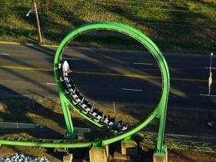
Handling Last Row Condition
DELIMITER //
CREATE PROCEDURE FetchData()
READS SQL DATA
BEGIN
DECLARE uid BIGINT UNSIGNED;
DECLARE ended INT(1) ;
DECLARE ucursor CURSOR FOR SELECT id FROM user;
DECLARE CONTINUE HANDLER FOR NOT FOUND SET ended = 1;
OPEN ucursor;
FLABEL: LOOP
FETCH ucursor INTO uid;
IF (ended=1) THEN LEAVE FLABEL;
END LOOP FLABEL;
CLOSE ucursor;
END;
//
DELIMITER ;
This example will stop because of the type of HANDLER definition.

Slide 98


SIGNAL Handling

Slide 99
SIGNAL Handling
DELIMITER //
CREATE PROCEDURE UserSignal (err VARCHAR(255))
BEGIN
SET @sql=CONCAT('UPDATE`', err, '` SET x=1');
PREPARE stmt FROM @sql;
EXECUTE stmt;
DEALLOCATE PREPARE stmt;
END;
//
DELIMITER ;
Notes:
In this case the error caused by the UPDATE command because a table with the name of an error message
does not exist, will force the calling routine to fail.

Slide 100
SIGNAL Handling
MySQL will deliver in the next releases the ability to access directly the SQLSTATE variables, as well as the ability to raise an error condition using the SIGNAL statement.
In the current 5.0.x release it is possible to create a generic SP that implements a SIGNAL workaround. It accepts an error message and then constructs dynamic SQL that includes that message within an invalid table name error.

Slide 101
SIGNAL Handling
DELIMITER //
CREATE PROCEDURE AddData(ident BIGINT UNSIGNED)
MODIFIES SQL DATA
BEGIN
DECLARE uid BIGINT UNSIGNED;
DECLARE p_sqlcode INT DEFAULT 0 ;
DECLARE p_message VARCHAR(255) ;
DECLARE duplicate INT(1) DEFAULT 0;
BEGIN
DECLARE DUPLICATE_KEY CONDITION FOR 1062;
DECLARE CONTINUE HANDLER FOR DUPLICATE_KEY BEGIN SET p_sqlcode=1062; SET p_message='Duplicate Key error'; END;
DECLARE CONTINUE HANDLER FOR NOT FOUND BEGIN SET p_sqlcode=1329; SET p_message='No Record Found'; END;
INSERT INTO user VALUES (ident);
IF (p_sqlcode<>0) THEN CALL UserSignal(p_message);
END IF;
END;
END;
//
DELIMITER ;
CALL AddData(10);
ERROR 1146 (42S02): Table 'examples.duplicate key error' doesn't exist
Notes:
The error handlers have a type which is CONTINUE so when the error is generated, the execution in the block
continues and the flow checks on the error and calls the UserSignal which generates an error.
In this case the client application receives an error when calls the stored procedure.
The error message can be caught by the client application.

Slide 102

Debugging

Slide 103
Debugging
MySQL does not have native debugging capabilities for SRs.
It is possible to debug a SR as well as any other part of MySQL server using a debugger tool such as gdb, etc.
Some open source tools (myProcDebugger) and some proprietary products are available for SR debugging.
The example below will create a debugging environment for SRs.

Slide 104
Debugging
The debugging environment includes a new database called debug, not strictly necessary (the idea is to have a set area for the debug constructs to reside), a table to hold the output and three stored procedures.
The table holds the debugging output. It has a procedure identifier (to use the debug across a number of procedures at once), a text column to hold debug statements and an identifier to order the results with some certainty.

Slide 105
Debugging
DROP TABLE IF EXISTS debug.debug;
CREATE TABLE debug.debug (
line_id int(11) NOT NULL auto_increment,
proc_id varchar(100) default NULL,
debug_output text,
PRIMARY KEY (line_id)
);

Slide 106
Debugging
The debug DB contains three SRs: DebugInsert, DebugOn and DebugOff.
DROP PROCEDURE IF EXISTS `debug`.`DebugInsert`;
DROP PROCEDURE IF EXISTS `debug`.`DebugOn`;
DROP PROCEDURE IF EXISTS `debug`.`DebugOff`;
DELIMITER //
CREATE PROCEDURE `DebugInsert `(IN p_proc_id varchar(100),IN p_debug_info text)
BEGIN
INSERT INTO debug (proc_id,debug_output) VALUES (p_proc_id,p_debug_info);
END;
//
DELIMITER ;

Slide 107
Debugging
DELIMITER //
CREATE PROCEDURE `DebugOn`(in p_proc_id varchar(100))
BEGIN
CALL debug.DebugInsert(p_proc_id,concat('Debug Started :',now()));
END;
//
DELIMITER ;
DELIMITER //
CREATE PROCEDURE `DebugOff`(in p_proc_id varchar(100))
BEGIN
CALL debug.DebugInsert(p_proc_id,concat('Debug Ended :',now()));
SELECT debug_output from debug WHERE proc_id=p_proc_id order by line_id;
DELETE from debug WHERE proc_id=p_proc_id;
END;
//
DELIMITER ;

Slide 108
Debugging
DROP PROCEDURE IF EXISTS `examples`.`TestDebug`;
DELIMITER //
CREATE PROCEDURE examples.TestDebug()
BEGIN
DECLARE pid varchar(100) DEFAULT 'TestDebug';
CALL debug.DebugOn(pid);
CALL debug.DebugInsert(pid,'Testing Debug');
CALL debug.DebugOff(pid);
END;
//
DELIMITER ;

Slide 109
Debugging
CALL examples.TestDebug();
examples.TestDebug();
+------------------------------------+
| debug_output |
+------------------------------------+
| Debug Started :2008-03-19 10:15:56 |
| Testing Debug |
| Debug Ended :2008-03-19 10:15:56 |
+------------------------------------+

Slide 110
Debugging
DROP PROCEDURE IF EXISTS dsql;
DELIMITER //
CREATE PROCEDURE dsql (table1 VARCHAR(20), field1 VARCHAR(20), val1 VARCHAR(100))
BEGIN
DECLARE pid varchar(100) DEFAULT ‘dsql’;
DECLARE var INTEGER DEFAULT 1;
SET @a:=val1;
CALL debug.DebugOn(pid);
SET @stmt_text=CONCAT("select * FROM ", table1, " WHERE ", field1 , " = ?");
CALL debug.DebugInsert(pid,CONCAT('Testing Value of SELECT Statement', "\t", @stmt_text));
PREPARE stmt FROM @stmt_text;
EXECUTE stmt USING @a;
DEALLOCATE PREPARE stmt;
SET @b=CONCAT(val1," .... ",val1);
CALL debug.DebugInsert(pid,CONCAT('Testing @b', "\t", @b));
SET @stmt_text=CONCAT("INSERT INTO ", table1, " (" , field1 , ") VALUES ( ? )" );
CALL debug.DebugInsert(pid,CONCAT('Testing Value of INSERT Statement', "\t", @stmt_text));
PREPARE stmt FROM @stmt_text; EXECUTE stmt USING @b; DEALLOCATE PREPARE stmt;
CALL debug.DebugOff(pid);
END;
//

Slide 111
Debugging
CALL dsql( “user", "ident", "vaue500 UNION ALL select * from user");
Empty set (0.00 sec)
+-------------------------------------------------------------------------------------------+
| debug_output |
+-------------------------------------------------------------------------------------------+
| Debug Started :2008-03-19 10:52:17 |
| Testing Value of SELECT Statement select * FROM user WHERE ident = ? |
| Testing @b vaue500 UNION ALL select * from user .... vaue500 UNION ALL select * from user |
| Testing Value of INSERT Statement INSERT INTO user (ident) VALUES ( ? ) |
| Debug Ended :2008-03-19 10:52:17 |
+-------------------------------------------------------------------------------------------+
CALL dsql (“user", "ident", "vaue500");
Empty set (0.00 sec)
+---------------------------------------------------------------------------+
| debug_output |
+---------------------------------------------------------------------------+
| Debug Started :2008-03-19 10:53:25 |
| Testing Value of SELECT Statement select * FROM user WHERE ident = ? |
| Testing @b vaue500 .... vaue500 |
| Testing Value of INSERT Statement INSERT INTO user (ident) VALUES ( ? ) |
| Debug Ended :2008-03-19 10:53:25 |
+---------------------------------------------------------------------------+
Notes:
If The routine aborts because of an error that has not been handled, it is always
possible to select from the debug.Debug table
select * from debug.Debug ORDER BY line_id;
If the error has been handled, it is possible to add the DebugOff routine in the handler code section.

Slide 112
Debugging
DROP PROCEDURE IF EXISTS dsql;
DELIMITER //
CREATE PROCEDURE dsql (table1 VARCHAR(20), field1 VARCHAR(20), val1 VARCHAR(100))
BEGIN
DECLARE pid varchar(100) DEFAULT ‘dsql’;
DECLARE var INTEGER DEFAULT 1;
DECLARE EXIT HANDLER FOR 1062 CALL debug.DebugInsert(pid,"Duplicate Key Error"); CALL debug.DebugOff(pid); ……….
SET @a:=val1;
CALL debug.DebugOn(pid);
SET @stmt_text=CONCAT("select * FROM ", table1, " WHERE ", field1 , " = ?");
CALL debug.DebugInsert(pid,CONCAT('Testing Value of SELECT Statement', "\t", @stmt_text));
PREPARE stmt FROM @stmt_text;
EXECUTE stmt USING @a;
DEALLOCATE PREPARE stmt;
SET @b=CONCAT(val1," .... ",val1);
CALL debug.DebugInsert(pid,CONCAT('Testing @b', "\t", @b));
SET @stmt_text=CONCAT("INSERT INTO ", table1, " (" , field1 , ") VALUES ( ? )" );
CALL debug.DebugInsert(pid,CONCAT('Testing Value of INSERT Statement', "\t", @stmt_text));
PREPARE stmt FROM @stmt_text; EXECUTE stmt USING @b; DEALLOCATE PREPARE stmt;
CALL debug.DebugOff(pid);
END;
//

Slide 113
Debugging
CALL dsql(“user", "ident", "vaue800");
+---------------------------------------------------------------------------+
| debug_output |
+---------------------------------------------------------------------------+
| Debug Started :2008-03-19 11:01:00 |
| Testing Value of SELECT Statement select * FROM user WHERE ident = ? |
| Testing @b vaue600 .... vaue600 |
| Testing Value of INSERT Statement INSERT INTO user (ident) VALUES ( ? ) |
| Duplicate Key Error |
| Debug Ended :2008-03-19 11:01:11 |
+---------------------------------------------------------------------------+
Empty set (0.00 sec)
CALL dsql(“user", "ident", "vaue800");
+---------------------------------------------------------------------------+
| debug_output |
+---------------------------------------------------------------------------+
| Debug Started :2008-03-19 11:01:11 |
| Testing Value of SELECT Statement select * FROM user WHERE ident = ? |
| Testing @b vaue800 .... vaue800 |
| Testing Value of INSERT Statement INSERT INTO user (ident) VALUES ( ? ) |
| Debug Ended :2008-03-19 11:01:11 |
+---------------------------------------------------------------------------+
Query OK, 5 rows affected (0.00 sec)

Slide 114

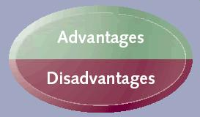
SR Advantages and Disadvantages

Slide 115
Stored Routines Dominant Patterns
The real power of SRs is realized when business rules and intelligent processing are included within them.
They are a powerful alternative to reduce complexity in the client application side. They can be used for complex Data Manipulation Language (DML) operations (lots of transactional statements).
They can reduce network traffic between the server and the client.

Slide 116
Stored Routine Advantages
SRs are executed far more often that they are written.
SRs help concentrating the business logic of the DB only in one place. They help separating the business logic of the application from the underlying data model.
SRs help reducing communication and network traffic for data intensive applications.
SRs are portable and there is no need to re-create the logic in all the clients.
Notes:
SRs help reducing network traffic.
Data intensive repetitive tasks may require getting results on client, apply logic to them, and getting more results, etc.).
If the network traffic is a bottleneck and the repetitive tasks and logic need to be applied to the original result set,
then stored routines could execute all the SQL statements needed and the filtering, sorting of the data results.
SRs could be used when having different types of clients interacting with the same type of server.
In this case there is no need to recreate the statement logic in each client.
Moreover, when writing SRs in PSL, you know that it will run on every platform that MySQL runs on,
without obliging you to install an additional runtime-environment package.
SRs are portable among MySQL servers and applications, but not among different types of SQL servers.
The reason for that is due to the differences in implementation of SRs among SQL vendors.

Slide 117
Stored Routines Advantages
SRs could be used to reduce complex SQL statements. Complex SQL statements (joins and correlated queries) are very hard to optimize. Using a procedural approach (breaking down the complex SQL statements) it is possible to specify the desiderate specs for processing, reducing and gluing the statements.

Slide 118
Stored Routines Advantages
SRs ensure a consistent and secure environment, where applications and users do not need to have access to the database tables directly, but can only execute specific stored routines.
SRs can help securing an environment resistant to SQL injections.
SPs (no SFs or Triggers) can help with parse overhead (similar to prepared statements, dynamic SQL).
Notes:
SRs were introduced in the 90’s. One of the main reasons for their
implementation was fro helping with security. There are two scenarios when
SRs help with security:
It is possible to give greater privileges to tables than those needed by the user to execute the stored routine (e.g. bank transactions)
It is possible to use SRs to build an environment resistant to SQL injections.
SQL injections occurs when a program, not very sophisticated, accepts some data from the user and the data is run or executed inside the SQL server.
If the program is not very wise, the SQL statement included in the code, could end up with extra statements
(inserted by a malicious user) that would run in the SQL server and possibly damage the server or retrieve data to which the user is not entitled.

Slide 119
Stored Routines Disadvantages
SPL is not optimized for number crunching, for complex mathematical operations. Complex mathematical operations or compute intensive operations are better to implemented in other programming languages (C, C++, PHP, etc.).
SQL is highly optimized for SET operations within groups of data, while reading data row by row may not always be as effective as reading groups, chunks of data.
Notes:
SPL is not very effective in number crunching, especially in the scenario with complex mathematical operations,
lots of calculation and little data interaction.
This is true for all SQL server types.
If the SQL server is cpu bound, the complex mathematical operations are better to be executed using
other programming languages.
SQL is highly optimized for operations within groups of data, while reading data row by row could result in a slightly slower process.

Slide 120
Stored Routines Disadvantages
Debugging SRs in environment with complex business logic is not trivial.
Portability across Stored Program Languages is not trivial.
SRs lack a couple of ANSI standard features: the ability to SIGNAL user own exceptions, the possibility with a single handler to manage all the possible exceptions.
SR Recursion.
Notes:
Debugging SRs in an environment with complex business logic, is not a trivial.
Having complex business logic and splitting the login in an arbitrary way between the
Middle Tier (e.g. written using PHP) and the DB with the SRs, may not be the best approach.
This is specially true because of the difficulties, problems that
may arise in certain scenarios and the need to debug the SPs and the lack of expertise on the SP side.
The solution is to have a Middle Tier Object or Data Access Object that contains all the Database Business Logic.
In this solution SRs may not be needed in most of the cases.
SR Recursion.
Stored Functions cannot be recursive.
Stored Procedures can be recursive, but this feature is disabled by default (max_sp_recursion_depth = 0)
The recursion depth is controlled by the variable max_sp_recursion_dept.
Most of the times iterative methods are always faster and more scalable.
To enable the max_sp_recursion_depth needs to be set to a nonzero value.
Portability across PSLs is not yet achievable.
This is especially true when you have an application that interacts with several SQL server types, such as MySQL, Microsoft SQL, Oracle, etc.
In this scenario the application code needs to change (e.g. when checking on the result set) depending on the server type interaction.
On one hand, it could be easy to switch between MySQL and Microsoft SQL and have the same piece of code in the client side to check the result sets.
On the other hand, it is not easy to switch between MySQL and Oracle on the client side.
Currently in MySQL PSL is not possible to define an exception handler that could be used for any type of error and could report the error code, etc..
It is not possible to view the error code that generated the specific exception.
At the moment the SR must define an exception handler for each possible error case, circumstance.
SR are relative mature in MySQL, even though a great job has already been done.
Within next releases MySQL SRs will be faster and more robust, with compiler and interpreter becoming more mature and
with the implementation of a more generic exception handler to manage all the possible exceptions and errors.

Slide 121
Stored Routines Disadvantages
It is not possible to use Dynamic SQL inside SFs or Triggers.
The following statements are not allowed in SRs: CHECK TABLE, LOCK TABLES, UNLOCK TABLES, LOAD DATA.

Slide 122
Stored Routines Best Practices
Create SRs using standard, predefined templates.
Create and store SRs source code using a revision control system, such as Subversion (SVN), Concurrent Versions System (CVS), etc.
Do not over use global variables.

Slide 123

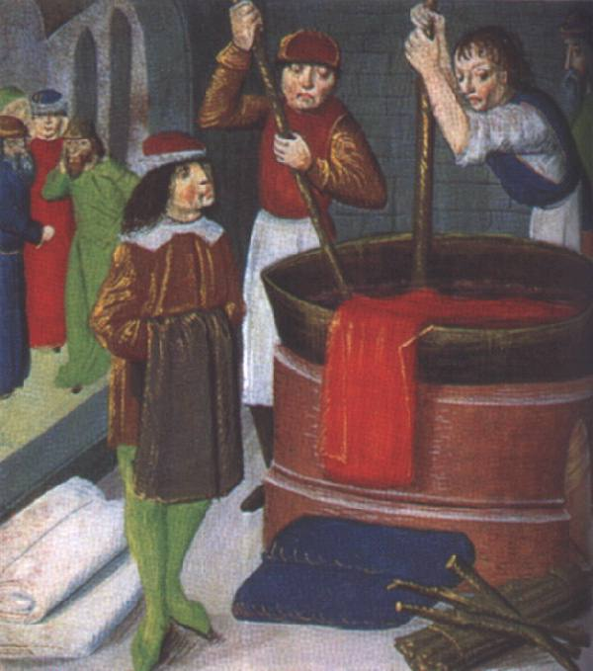
Optimizations

Slide 124
Optimizations
Reducing Network Traffic with SRs
SQL Statement Optimization using SRs
Stored Routine Optimization
Notes:
Stored Programs could be used as an alternative to perform queries or DML operations that perform badly in standard SQL.
This happens when using complex SQL statements (e.g. self-joins, correlated queries) or
when the optimizer is not able to choose the best plan for a specific query.

Slide 125
Reducing Network Traffic with SRs
When an application, client program is required to process a large number of rows from the DB or to access several times the DB to perform a client operation, an SR can outperform a program written in client languages, because it does not have to wait for rows to be transferred across the network.

Slide 126
Reducing Network Traffic with SRs
It's common for an application to accept input from an end user, read some data in the DB, decide what statement to execute next, retrieve a result, make a decision, execute some SQL statements, and so on. If the application code is entirely written outside the DB, each of these steps would require a network round trip between the DB and the application.

Slide 127
Reducing Network Traffic with SRs
The time taken to perform these network trips easily can dominate overall user response time.
Consider a typical interaction between a bank customer and an ATM machine.
The user requests a transfer of funds between two accounts.

Slide 128
Reducing Network Traffic with SRs
The application must retrieve the balance of each account from the DB, check withdrawal limits and possibly other policy information, issue the relevant UPDATE statements, and finally issue a commit, all before advising the customer that the transaction has succeeded.

Slide 129
Reducing Network Traffic with SRs
Even for this relatively simple interaction, at least six separate DB queries must be issued, each with its own network round trip between the application server and the DB.
The next figure shows the sequences of interactions that would be required without an SR.

Slide 130
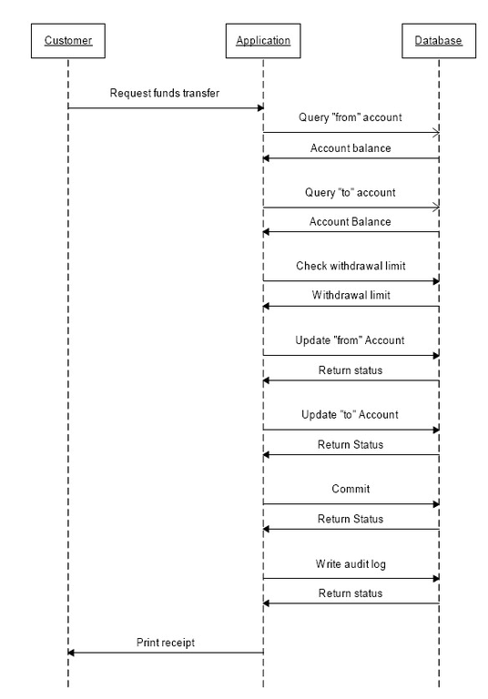
Reducing Network Traffic with SRs

Slide 131
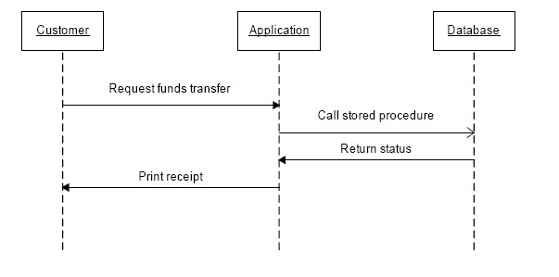
Reducing Network Traffic with SRs

Slide 132
Reducing Network Traffic with SRs
Network round trips can also become significant when a client is required to perform some kind of aggregate processing on very large record sets in the DB.

Slide 133
Reducing Network Traffic with SRs
For instance, if the application needs to retrieve millions of rows in order to calculate some sort of business, that cannot be computed easily using native SQL, such as average time to complete an order, a very large number of round trips can result.

Slide 134

SRs an Alternative to Complex SQL
Notes:
SRs can be used as a valid alternative to Complex SQL statements and constructs.
However, inappropriate use can lead to opposite effects.
Stored Programs could be used as an alternative to perform queries or DML operations that perform badly in standard SQL.
This happens when using complex SQL statements (e.g. self-joins, correlated queries) or
when the optimizer is not able to choose the best plan for a specific query.

Slide 135
SRs an Alternative to Complex SQL
Divide and Conquer very complex SQL. Complex SQL statements are hard to optimize, especially when they contain several subqueries and joins.
Adopt a procedural approach breaking down the statements (override the optimizer), specifying the desiderate specs, for processing and statement reduction.
Notes:
Stored Programs could be used as an alternative to perform queries or DML operations that perform badly in standard SQL.
This happens when using complex SQL statements (e.g. self-joins, correlated queries) or
when the optimizer is not able to choose the best plan for a specific query.

Slide 136
SRs an Alternative to Complex SQL
Reduction in parse overhead (similar to prepared statement).
Two types of complex SQL statements, that could offer a better solution using SRs, are examined: self-joins and correlated queries.

Slide 137
SRs an Alternative to Complex SQL
Avoid Self-Joins with Procedural Analysis
Avoid Correlated Queries

Slide 138
Avoid Self-Joins
A Self-Join is a query that joins a table to itself in order to filter for the required rows.
SELECT … FROM table1 t1,
(SELECT ….. FROM table1) t2
WHERE t1.field1=t2.field1 AND t1.field2=t2.field2;
For instance an SQL statement that retrieves the most valuable order for each customer over the past few months.

Slide 139
Avoid Self-Joins
SELECT s.customer_id,s.product_id,s.quantity, s.sale_value FROM sales s,
(SELECT customer_id, max(sale_value) as max_sale_value FROM sales GROUP BY customer_id) t
WHERE t.customer_id=s.customer_id AND t.max_sale_value=s.sale_value AND s.sale_date>date_sub(currdate(),interval 6 month);

Slide 140
Avoid Self-Joins
DROP PROCEDURE IF EXISTS MaxSaleByCustomer ;
DELIMITER //
CREATE PROCEDURE MaxSaleByCustomer()
MODIFIES SQL DATA
BEGIN
DECLARE counter INT DEFAULT 0; DECLARE last_sale INT DEFAULT 0; DECLARE l_last_customer_id INT DEFAULT -1;
DECLARE l_customer_id, l_product_id, l_quantity INT; DECLARE l_sale_value DECIMAL(8,2);
DECLARE s_cursor CURSOR FOR SELECT customer_id, product_id, quantity, sale_value FROM sales
WHERE sale_date>date_sub(currdate(), interval 6 month) ORDER BY customer_id, sale_value DESC;
DECLARE CONTINUE HANDLER FOR NOT FOUND SET last_sale=1;
OPEN s_cursor;
SLOOP: LOOP
FETCH s_cursor INTO l_customer_id,l_product_id,l_quantity,l_sale_value;
IF (last_sale=1) THEN LEAVE SLOOP; END IF;
IF l_customer_id <> l_last_customer_id THEN
INSERT INTO max_sales_by_customer (customer_id, product_id,quantity,sale_value) VALUES (l_customer_id,l_product_id,l_quantity,l_sale_value);
END IF;
SET l_last_customer_id=l_customer_id;
END LOOP;
CLOSE s_cursor;
END;
//
DELIMITER ;

Slide 141
Correlated Queries
A correlated select is a SELECT statement that contains a correlated subquery in the WHERE clause
SELECT table1.field1,
(SELECT sum(t2.field3) FROM table2 t2
WHERE t1.field1=t2.field2
AND ...... =(SELECT max(t3.field4) FROM table3 t3))
FROM table1 t1 WHERE t1.field1IN
(SELECT t4.field2 FROM table2 t4 WHERE ……..)

Slide 142
Correlated Queries
A correlated update is an UPDATE statement that contains a correlated subquery in the SET clause and/or in WHERE clause.
Correlated updates are often good candidates for optimization through SRs.
UPDATE table1 t1 SET field1 = (SELECT …FROM table2 t2 WHERE t2.field2=t1.field1 AND t2.field3=t1.field3 …)
WHERE (t1.field1, t1.field2, …) IN (SELECT … FROM table2 t3);

Slide 143
Correlated Queries
The UPDATE statement updates all customers who are also employees, and assigns the employee's manager as their sales representative.
The UPDATE statement needs to identify those customers who are employees and their manager’s identifiers.
Notes:
The UPDATE statement needs to access the employee table twice: once to identify customers who are employees and again to find the manager’s identifier for those employes.

Slide 144
Correlated Queries
UPDATE customers c SET sales_rep_id =
(SELECT manager_id FROM employees
WHERE surname = c.contact_surname AND
firstname = c.contact.firstname AND
date_of_birth = c.date_of_birth)
WHERE (contact_surname, contact_firstname, date_of_birth) IN (SELECT surname, firstname, date_of_birth FROM employees)
Notes:
The UPDATE statement needs to access the employee table twice: once to identify customers who are employees and again to find the manager’s identifier for those employes.

Slide 145
Correlated Queries
DROP PROCEDURE IF EXISTS UpdateEmployeeCustomers;
DELIMITER //
CREATE PROCEDURE UpdateEmployeeCustomers ()
MODIFIES SQL DATA
BEGIN
DECLARE last_customer INT DEFAULT 0;
DECLARE l_customer_id,l_manager_id INT;
DECLARE s_cursor CURSOR FOR SELECT c.customer_id,e.manager_id FROM customers c, employees e
WHERE e.surname=c.contact_surname AND e.firstname=c.contact_firstname AND e.date_of_birth=c.date_of_birth ;
DECLARE CONTINUE HANDLER FOR NOT FOUND SET last_customer=1;
OPEN s_cursor;
SLOOP: LOOP
FETCH s_cursor INTO l_customer_id,l_manager_id;
IF (last_customer=1) THEN LEAVE SLOOP; END IF;
UPDATE customers SET sales_rep_id=l_manager_id WHERE customer_id=l_customer_id;
END LOOP;
CLOSE s_cursor;
END;
//
DELIMITER ;
Notes:
Because the SP does not have to do two separate accesses of the customers table, it is significantly faster than standard SQL.

Slide 146

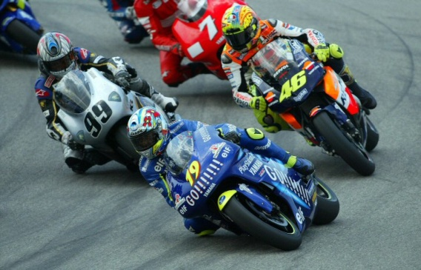
Stored Routines Optimization

Slide 147
Stored Routine Optimization
The performance of SQL within an SR will usually dominate overall performance.
When SQL is tuned, optimize the stored program using traditional optimization techniques, such as logic, testing, looping optimization and avoid recursion.

Slide 148
Stored Routine Optimization
Branching Optimization (Logic and Testing)
Looping Optimization
Avoid Recursion
Cursor and Triggers overhead

Slide 149

Stored Routine Optimization
Branching Optimization
Looping Optimization
Recursion
Cursor and Trigger Overhead

Slide 150

Branching Optimization
Optimize Logic and Testing.
Order tests by frequency.
Stop testing when you know the answer.
Notes:
Branching Optimization is especially important if the conditional statements are inside loops.
The essence of optimizing conditional statements like IF and CASE is to reduce the number of comparisons that are performed.
This could be achieved in the following way:
Testing for the more likely matches earlier in the IF or CASE statement
Stopping the comparison process as early as possible.
Reduce the number of comparisons by testing for the most likely match first, and nest IF or CASE statements when necessary to
Eliminate unnecessary comparisons.

Slide 151
Branching Optimization
DELIMITER //
CREATE PROCEDURE SetUserInfo (t1prefix VARCHAR(32), t2prefix VARCHAR(32), etype VARCHAR(20), uid INT)
SQL SECURITY INVOKER
BEGIN
DECLARE error INT DEFAULT 0;
BEGIN
DECLARE EXIT HANDLER FOR SQLSTATE '42S01' SET error=2;
DECLARE EXIT HANDLER FOR SQLEXCEPTION SET error=1;
SET @smt = CONCAT(“ …… ?”);
PREPARE stmt FROM @smt;
EXECUTE stmt;
DEALLOCATE PREPARE stmt;
END;
-- The procedure should succeed most of the times
IF error=0 THEN
BEGIN …… END;
ELSEIF error=1 THEN ……………
ELSE
-- This should be the case where there is a warning which is the least frequent scenario
…….
END IF;
……..

Slide 152


Branching Optimization
…….
IF (e_status='U' AND e_salary > 150000) THEN .....
ELSEIF (e_status='U' AND e_salary > 100000) THEN .......
ELSEIF (e_status='U' AND e_salary > 50000) THEN ....
ELSE ....
END IF;
……..
……..
IF (e_status='U') THEN
IF (e_salary > 150000) THEN
ELSEIF ((e_salary > 100000) && (e_salary <= 150000)) THEN .....
ELSEIF ((e_salary > 50000) && (e_salary <= 100000) THEN .....
ELSE .....
END IF;
END IF;
Notes:
Avoid unnecessary comparisons

Slide 153
CASE versus IF
IF var1=1 THEN …
ELSEIF var1=2 THEN ……
ELSEIF var1=3 THEN …..
ELSEIF var1=4 THEN ….
ELSE …….
END IF;
CASE var1
WHEN 1 THEN …..;
WHEN 2 THEN ….
WHEN 3 THEN ….
WHEN 3 THEN …..
WHEN 4 THEN ….
END CASE;

Slide 154
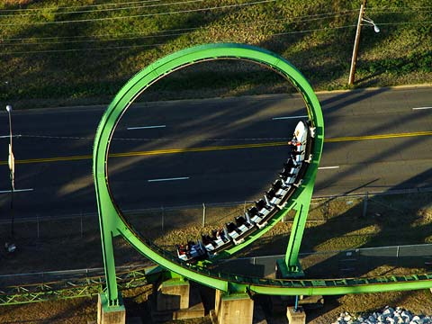
Stored Routine Optimization
Branching Optimization
Looping Optimization
Recursion
Cursor and Trigger Overhead

Slide 155

Looping Optimization
Optimize Iterations.
Move loop invariant statements out of loop.
Ensure that no unnecessary statements occur within a loop.
Exit a loop as soon as possible.
Notes:
Move loop invariant statements out of loops: whatever is part
of a loop needs to be inside the loop all the rest should be moved
out of it.

Slide 156

Looping Optimization
WHILE (i<1000) DO
WHILE (j < 100) DO
……
SET sqri = sqrt(i);
SET sqrj = sqrt(j); SET tot = tot + sqri + sqrj; SET j=j+1;
END WHILE;
SET i=i+1;
END WHILE;
WHILE (i<1000) DO
SET sqri = sqrt(i);
WHILE (j < 100) DO
……
SET sqrj = sqrt(j);
SET tot = tot + sqri + sqrj; SET j=j+1;
END WHILE;
SET i=i+1;
END WHILE;

Slide 157

Stored Routine Optimization
Branching Optimization
Looping Optimization
Recursion
Cursor and Trigger Overhead
Mandelbrot set?
Notes:
A Sierpinski triangle—a confined recursion of triangles to form a geometric lattice.

Slide 158
Recursion
Recursion is controlled by the server variable max_sp_recursion_dept.
Recursion is applicable only to SPs.
SPs can be recursive, but this feature is disabled by default (max_sp_recursion_dept=0).
The max_sp_recursion_depth could be increased. Its limit is 255.

Slide 159
Recursion
Recursion tend to be slower than iteration. Recursion usually degrades performance rapidly as the recursion depth increases.
Recursion tend to use large amount of memory. In some case the server thread stack has to be enlarge to avoid thread stack overrun.
Iterative alternatives are almost always faster and more scalable.

Slide 160
Recursion
DROP PROCEDURE IF EXISTS Factorial;
DELIMITER //
CREATE PROCEDURE Factorial (num INT, OUT tot BIGINT UNSIGNED, OUT err INT )
SQL SECURITY DEFINER
COMMENT 'This procedure calculates the factorial'
BLABEL: BEGIN
DECLARE THREAD_STACK_OVERRUN CONDITION FOR 1436;
DECLARE RECUSION_DEPTH_EXCEEDED CONDITION FOR 1456;
DECLARE EXIT HANDLER FOR THREAD_STACK_OVERRUN BEGIN SET err=2; SELECT CONCAT('Error ', err) as result; END;
DECLARE EXIT HANDLER FOR RECURSION_DEPTH_EXCEEDED BEGIN SET err=3; SELECT CONCAT('Error ', err) as result; END;
SET tot=1;
IF (num < 2) THEN SET tot=1;
ELSE
CALL Factorial(num-1, tot, err);
IF (err IS NULL ) THEN
SET tot=num * tot;
END IF;
END IF;
END BLABEL
//
DELIMITER ;
Notes:
--
-- If you declare in this way the error handlers this will be the priority order in which the errors will be handled
So if error 1436 happen than err=2 even though is still an SQL exception
If I would not use the first two command lines for handlers and the error 1436 or 1456 would occur, so
the handler for SQLEXCEPTIOn would kick off.
In theory in this example the error variable could be set to 0 so when it exits from the routine,
from all the recursion the external variable check does not have to be against NULL.
The next example will show that.
In order to have recursion depth higher than 20, the server thread stack variable had to be increased.
The comparisons between the recursive and iterative approach did stop at the calculation for the factorial of 65, due to the capacity
of the unsigned bigint.
The error 1436 is generated when there is a thread stack overrun.
The error 1456 is generated when the max recursion depth is reached.
If no error is handled and an error is generated, the routine call ends with an error.

Slide 161
Recursion
DROP PROCEDURE IF EXISTS Factorial;
DELIMITER //
CREATE PROCEDURE Factorial (num INT, OUT tot BIGINT UNSIGNED, OUT err INT )
SQL SECURITY DEFINER
COMMENT 'This procedure calculates the factorial'
BLABEL: BEGIN
DECLARE THREAD_STACK_OVERRUN CONDITION FOR 1436;
DECLARE RECUSION_DEPTH_EXCEEDED CONDITION FOR 1456;
DECLARE EXIT HANDLER FOR THREAD_STACK_OVERRUN BEGIN SET err=2; SELECT CONCAT('Error ', err) as result; END;
DECLARE EXIT HANDLER FOR RECURSION_DEPTH_EXCEEDED BEGIN SET err=3; SELECT CONCAT('Error ', err) as result; END;
SET tot=1; SET err=0;
IF (num < 2) THEN SET tot=1;
ELSE
CALL factorial(num-1, tot, err);
IF (err=0) THEN
SET tot=num * tot;
END IF;
END IF;
END BLABEL
//
DELIMITER ;
Notes:
The main difference between this slide (recursive method for factorial calculation) and the previous slide
is the management, set of the error and the consequent test.
CALL Factorial(10,@fact,@ee);
SELECT @fact, @ee;

Slide 162
Iteration
DROP PROCEDURE IF EXISTS IterativeFactorial;
DELIMITER //
CREATE PROCEDURE IterativeFactorial(num INT, OUT tot BIGINT UNSIGNED, OUT err INT )
SQL SECURITY DEFINER
COMMENT 'This procedure calculates the factorial number using an iterative method'
BLABEL: BEGIN
DECLARE j INT DEFAULT 0;
SET tot=1;
IF (num < 2) THEN SET tot=1; ELSE
SET j=2;
FLOOP: loop
SET tot=j * tot; SET j=j+1;
IF j <= num THEN ITERATE FLOOP; END IF;
LEAVE FLOOP;
END LOOP FLOOP;
END IF;
END BLABEL
//
DELIMITER ;

Slide 163
Iteration
DROP PROCEDURE IF EXISTS IterativeFactorial;
DELIMITER //
CREATE PROCEDURE IterativeFactorial(num INT, OUT tot BIGINT UNSIGNED, OUT err INT )
SQL SECURITY DEFINER
COMMENT 'This procedure calculates the iterative factorial number'
BLABEL: BEGIN
DECLARE j INT DEFAULT 0;
SET tot=1;
IF (num < 2) THEN SET tot=1;
ELSE
SET j=2;
WHILE (j <= num) DO
SET tot=j * tot; SET j=j+1;
END WHILE;
END IF;
END BLABEL
//
DELIMITER ;

Slide 164
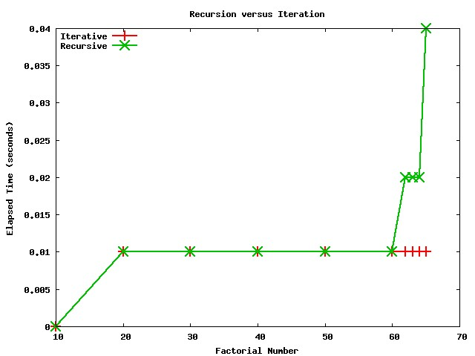
Recursion
Notes:
In this slide the recursive stored procedure and the iterative routine that used the loop construct are compared.
An equivalent comparison could be seen also in the case of the iterative method with the while construct is chosen.
The performance difference for the Factorial Number calculation is not as significant as in the following Fibonacci example.

Slide 165
Recursion
DROP PROCEDURE IF EXISTS Fibonacci;
DELIMITER //
CREATE PROCEDURE Fibonacci (num INT, OUT tot BIGINT UNSIGNED, OUT err INT )
SQL SECURITY DEFINER
COMMENT 'This procedure calculates the Fibonacci numbers'
BLABEL: BEGIN
DECLARE n1 BIGINT UNSIGNED DEFAULT 0;
DECLARE n2 BIGINT UNSIGNED DEFAULT 0;
DECLARE THREAD_STACK_OVERRUN CONDITION FOR 1436;
DECLARE RECUSION_DEPTH_EXCEEDED CONDITION FOR 1456;
DECLARE EXIT HANDLER FOR THREAD_STACK_OVERRUN BEGIN SET err=2; SELECT CONCAT('Error ', err) as result; END;
DECLARE EXIT HANDLER FOR RECURSION_DEPTH_EXCEEDED BEGIN SET err=3; SELECT CONCAT('Error ', err) as result; END;
SET tot=1;
IF (num=0) THEN SET tot=0;
ELSEIF (num=1) THEN SET tot=1;
ELSE
CALL Fibonacci(num-1, n1, err); CALL Fibonacci(num-2, n2, err);
IF (err IS NULL ) THEN SET tot=(n1 + n2); END IF;
END IF;
END BLABEL
//
DELIMITER ;

Slide 166
Iteration
DROP PROCEDURE IF EXISTS IterativeFibonacci;
DELIMITER //
CREATE PROCEDURE IterativeFibonacci(num INT, OUT tot BIGINT UNSIGNED, OUT err INT )
SQL SECURITY DEFINER
COMMENT 'This procedure calculates the factorial'
BLABEL: BEGIN
DECLARE m BIGINT UNSIGNED DEFAULT 0;
DECLARE k BIGINT UNSIGNED DEFAULT 1;
DECLARE i BIGINT UNSIGNED DEFAULT 1;
DECLARE j BIGINT UNSIGNED DEFAULT 0;
SET tot=0;
WHILE (i<=num) DO
SET j=m+k; SET m=k; SET k=j; SET i=i+1;
END WHILE;
SET tot=m;
END BLABEL
//
DELIMITER ;

Slide 167
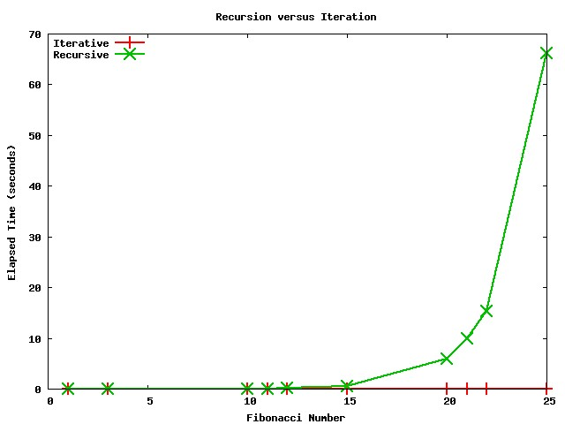
Recursion versus Iteration
Notes:
Comparing Fibonacci algorithm performance of the recursive and non recursive (iterative) implementations,
it is possible to denote that the recursive algorithm is less efficient that the iterative one as soon as
the number of recursions increases.
Each recursion requires MySQL to create the context for a new stored program invocation.
As a result, a recursive algorithm tends to use more memory (this is very visible with the factorial algorithm)
as well as being slower than the iterative alternative.

Slide 168

Stored Routine Optimization
Branching Optimization
Looping Optimization
Recursion
Cursor and Trigger Overhead

Slide 169
Cursor Overhead
When retrieving a single row from a SELECT statement, using INTO is far easier and slightly faster than using a CURSOR.
The use of a CURSOR involves DECLARE, OPEN, FETCH and CLOSE statements.

Slide 170
Trigger Overhead
Every DB Trigger is associated with a specific DML operation (INSERT, UPDATE, etc.) on a specific table. The Trigger code gets executed for each row affected by the DML operation (FOR EACH ROW).
A single DML operation might potentially affect thousands of rows, so the body associated to a trigger might get executed thousands of times and increase significantly the amount of time taken to execute the DML operation.

Slide 171
Trigger Overhead
Code inside a Trigger body needs to be as lightweight as possible and any SQL statement in the trigger should be properly optimized.

Slide 172

Profiling

Slide 173
Profiling
MySQL SQL Profiler is built into the DB server and can be dynamically enabled/disabled via the client. To begin profiling one or more SQL queries, simply issue the following command:
SET profiling=1;
Execute an SQL statement or an SR.
To get a quick summary execute the command
SHOW PROFILE and to get the full profile report execute SHOW PROFILE ALL.

Slide 174
Profiling
MySQL SQL Profiler command include:
  ALL - displays all information,
  BLOCK IO - displays counts for block input and output operations
  CONTEXT SWITCHES - displays counts for voluntary and involuntary context switches,
  IPC - displays counts for messages sent and received,
  MEMORY - is not currently implemented,
  PAGE FAULTS - displays counts for major and minor page faults,
  SOURCE - displays the names of functions from the source code, together with the name and line number of the file in which the function occurs,
  SWAPS - displays swap counts.

Slide 175
Profiling
SELECT * FROM user;
SHOW PROFILE;
+--------------------------------+----------------------------------------------------+
| Status | Duration |
+--------------------------------+----------------------------------------------------+
| (initialization) | 0.000009 |
| checking query cache for query | 0.000071 |
| Opening tables | 0.000018 |
| System lock | 0.00001 |
| Table lock | 0.0000660 |
| init | 0.000034 |
| optimizing | 0.00001 |
| statistics | 0.000027 |
| preparing | 0.000027 |
| executing | 0.000006 |
| Sending data | 0.000252 |
| end | 0.000035 |
| query end | 0.000015 |
| storing result in query cache | 0.000014 |
| freeing items | 0.000346 |
| closing tables | 0.000015 |
| logging slow query | 0.000007 |
+--------------------------------+------------------------------------------------------+

Slide 176
Profiling
DROP PROCEDURE IF EXISTS PSelect;
DELIMITER //
CREATE PROCEDURE PSelect()
BEGIN
SELECT * FROM user;
END;
//
DELIMITER ;

Slide 177
Profiling
SHOW PROFILE;
+--------------------------------+-----------------------------------------------------+
| Status | Duration |
+--------------------------------+---------------------------------------------------+
| (initialization) | 0.000033 |
| Opening tables | 0.000018 |
| System lock | 0.000009 |
| Table lock | 0.000335 |
| checking query cache for query | 0.000016 |
| Opening tables | 0.000013 |
| System lock | 0.000007 |
| Table lock | 0.000056 |
| init | 0.000036 |
| optimizing | 0.000011 |
| statistics | 0.000027 |
| preparing | 0.000028 |
| executing | 0.000008 |
| Sending data | 0.00025 |
| end | 0.000016 |
| query end | 0.000006 |
…… Continuation

Slide 178
Profiling
SHOW PROFILE;
+--------------------------------+-----------------------------------------------------+
| Status | Duration |
+--------------------------------+---------------------------------------------------+
………. Continuation ……..
| closing tables | 0.000015 |
| storing result in query cache | 0.000063 |
| query end | 0.000015 |
| freeing items | 0.000028 |
| logging slow query | 0.000005 |
+--------------------------------+-------------------------------------------------------+

Slide 179
Profiling
DROP PROCEDURE IF EXISTS Factorial;
DELIMITER //
CREATE PROCEDURE Factorial (num INT, OUT tot BIGINT UNSIGNED, OUT err INT )
SQL SECURITY DEFINER
COMMENT 'This procedure calculates the factorial'
BLABEL: BEGIN
DECLARE THREAD_STACK_OVERRUN CONDITION FOR 1436;
DECLARE RECUSION_DEPTH_EXCEEDED CONDITION FOR 1456;
DECLARE EXIT HANDLER FOR THREAD_STACK_OVERRUN BEGIN SET err=2; SELECT CONCAT('Error ', err) as result; END;
DECLARE EXIT HANDLER FOR RECURSION_DEPTH_EXCEEDED BEGIN SET err=3; SELECT CONCAT('Error ', err) as result; END;
SET tot=1; SET err=0;
IF (num < 2) THEN SET tot=1;
ELSE
CALL factorial(num-1, tot, err);
IF (err=0) THEN
SET tot=num * tot;
END IF;
END IF;
END BLABEL
//
DELIMITER ;

Slide 180
Profiling
CALL Factorial (3, @fact,@err);
SHOW PROFILE;
+--------------------+-----------+
| Status | Duration |
+--------------------+-----------+
(initialization) | 0.00005 |
| Opening tables | 0.000114 |
| Opening tables | 0.000011 |
| closing tables | 0.000206 |
| Opening tables | 0.000029 |
| closing tables | 0.000067 |
| Opening tables | 0.000104 |
| Opening tables | 0.00001 |
| closing tables | 0.000022 |
| Opening tables | 0.000011 |
| closing tables | 0.000043 |
| Opening tables | 0.000086 |
| Opening tables | 0.00001 |
| closing tables | 0.000022 |
| Opening tables | 0.00001 |
| closing tables | 0.000024 |
| Opening tables | 0.00001 |
... Continuation

Slide 181
Profiling
show profile;
+--------------------+-----------+
| Status | Duration |
+--------------------+-----------+
… Continuation
closing tables | 0.00004 |
| query end | 0.000007 |
| closing tables | 0.000032 |
| Opening tables | 0.00001 |
| closing tables | 0.000023 |
| Opening tables | 0.000021 |
| closing tables | 0.000035 |
| query end | 0.000006 |
| closing tables | 0.000028 |
| Opening tables | 0.00001 |
| closing tables | 0.000045 |
| Opening tables | 0.000022 |
| closing tables | 0.0000649 |
| query end | 0.000006 |
| freeing items | 0.00003 |
| logging slow query | 0.00002
+--------------------+-----------+
33 rows in set (0.00 sec)

Slide 182
Iteration
DROP PROCEDURE IF EXISTS IterativeFactorial;
DELIMITER //
CREATE PROCEDURE IterativeFactorial(num INT, OUT tot BIGINT UNSIGNED, OUT err INT )
SQL SECURITY DEFINER
COMMENT 'This procedure calculates the factorial number using an iterative method'
BLABEL: BEGIN
DECLARE j INT DEFAULT 0;
SET tot=1;
IF (num < 2) THEN SET tot=1; ELSE
SET j=2;
FLOOP: loop
SET tot=j * tot; SET j=j+1;
IF j <= num THEN ITERATE FLOOP; END IF;
LEAVE FLOOP;
END LOOP FLOOP;
END IF;
END BLABEL
//
DELIMITER ;

Slide 183
Profiling
CALL IterativeFactorial(3, @fact,@err);
show profile;
+--------------------+-----------+
| Status | Duration |
+--------------------+-----------+
| (initialization) | 0.000005 |
| Opening tables | 0.000023 |
| System lock | 0.000014 |
| Table lock | 0.0005509 |
| Opening tables | 0.000011 |
| closing tables | 0.000022 |
| Opening tables | 0.000011 |
| closing tables | 0.000022 |
| Opening tables | 0.000016 |
| closing tables | 0.000023 |
| Opening tables | 0.000011 |
| closing tables | 0.000022 |
| Opening tables | 0.000025 |
| closing tables | 0.000022 |
| Opening tables | 0.000022 |
| closing tables | 0.000024 |
… Continuation

Slide 184
Profiling
+--------------------+-----------+
| Status | Duration |
+--------------------+-----------+
.. Continuation
Opening tables | 0.000012 |
| closing tables | 0.000028 |
| Opening tables | 0.000021 |
| closing tables | 0.000024 |
| Opening tables | 0.00002 |
| closing tables | 0.000023 |
| Opening tables | 0.000018 |
| closing tables | 0.000067 |
| query end | 0.000008 |
| freeing items | 0.000032 |
| logging slow query | 0.000016 |
+--------------------+-----------+
27 rows in set (0.00 sec)

Slide 185
Profiling
Profiling is initially turned off for each session.
By default, you can store 15 different query profiles for your session. You can increase this up to 100 by setting the profiling_history_size session variable. Certain diagnostics rely on operating system support for the getrusage() system call, so you may see NULL values for some statistics if you're on a platform that doesn't support this function.

Slide 186

Q&A
Thanks for your attention!
I would like to thank The Hive for making this tutorial possible.

